Slide 1



Capstone Project Phase 1
ProConnect
Advisor: Ronen Zilber
Students: Hadi Danial, Abd Elaziz Hamed

Slide 2
Main Players
Homeowners
Contractors
Professionals
Workers

Slide 3

The Solution
Application and website to solve this problem.
Centralized platform.
Powerful tools for Contractors, professionals and workers.
Lack experience homeowners.
Solve Reliability issue.

Slide 4

The Problem
Homeowners
Finding professionals, Contractors

Slide 5

The Problem
Contractors
Finding professionals
Manage their job

Slide 6

The Problem
Professionals
Managing Jobs
Finding job
Finding reliable Contractor

Slide 7

The Problem
Workers
Finding professionals

Slide 8

Technologies
React Native
Spring Boot
RSA encryption
SQL Database (MySQL)

Slide 9
React Native
A cross-platform mobile development framework
Cross-platform development: Develop for multiple platforms with the same codebase.
Native-Like performance by utilizing native components and rendering them using JavaScript.
Hot Reload allows developers to see real-time changes in the app without recompiling or restarting the application.
Active community with lots of tutorials and third-party libraries that provide additional functionality.

Slide 10
Spring Boot
A powerful Java-based framework for developing back-end systems
Advantages
Disadvantages
Embedded web server, HTTP requests and routing
Dependency Injection enabling easy management and injection of dependencies
Easy database integration with consistent API
Security: supports authentication, authorization and encryption
Complex configuration
Dependency Injection enabling easy management and injection of dependencies
Easy database integration with consistent API
Security: supports authentication, authorization and encryption

Slide 11
RSA Encryption
Advantages
Asymmetric encryption algorithm
Strong security
Secure key exchange
But slower encryption

Slide 12
Database (MySQL)
-
Relational Database management system
Powerful Query Language
Data Integrity
Scalability Challenges

Slide 13
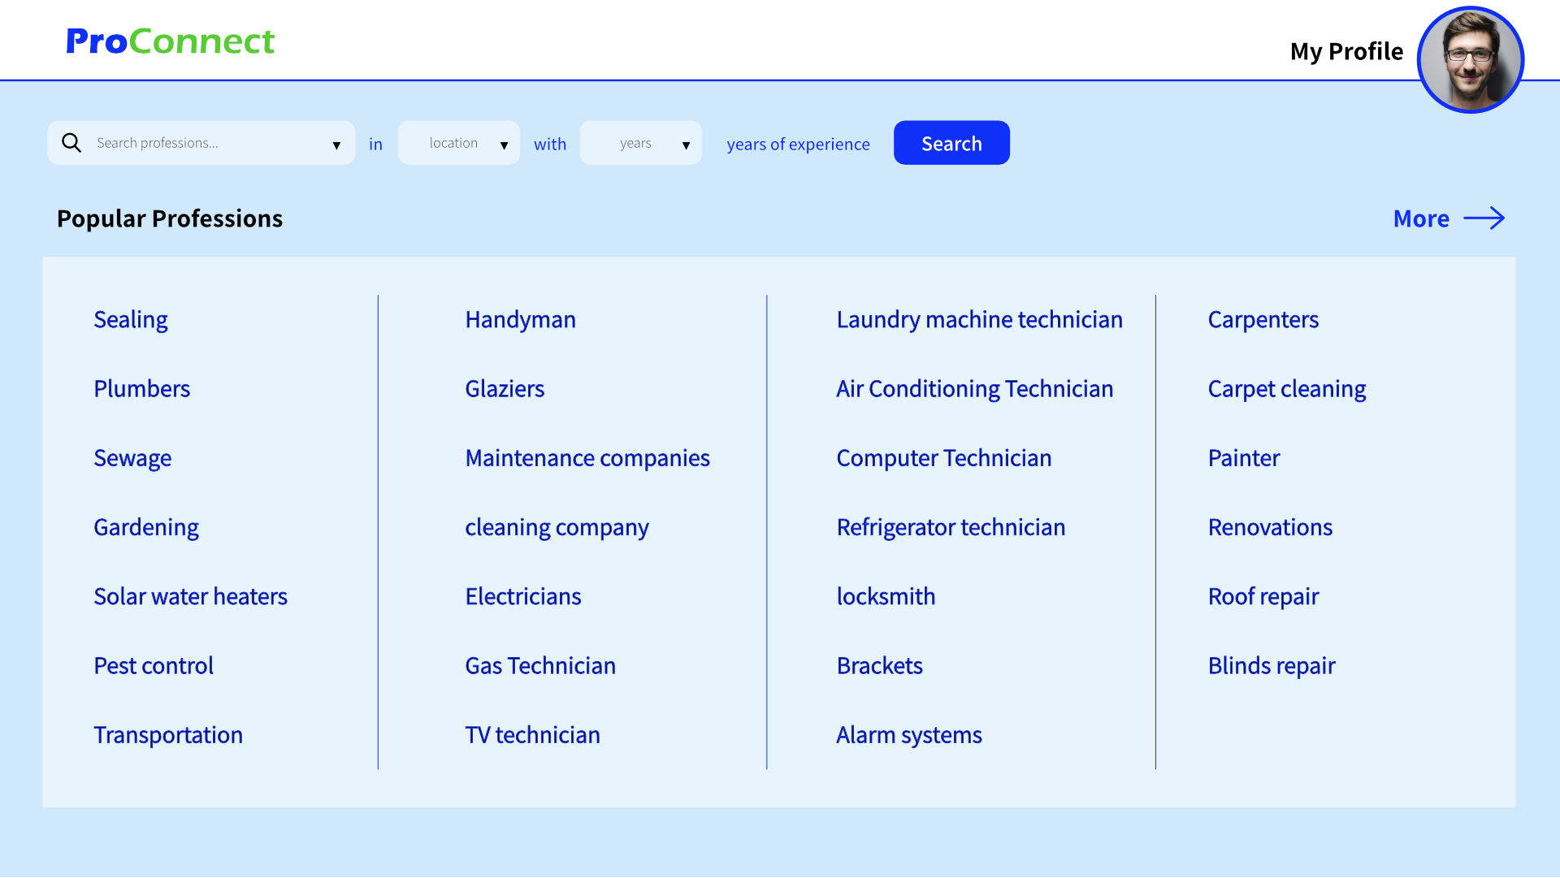
Home Page

Slide 14
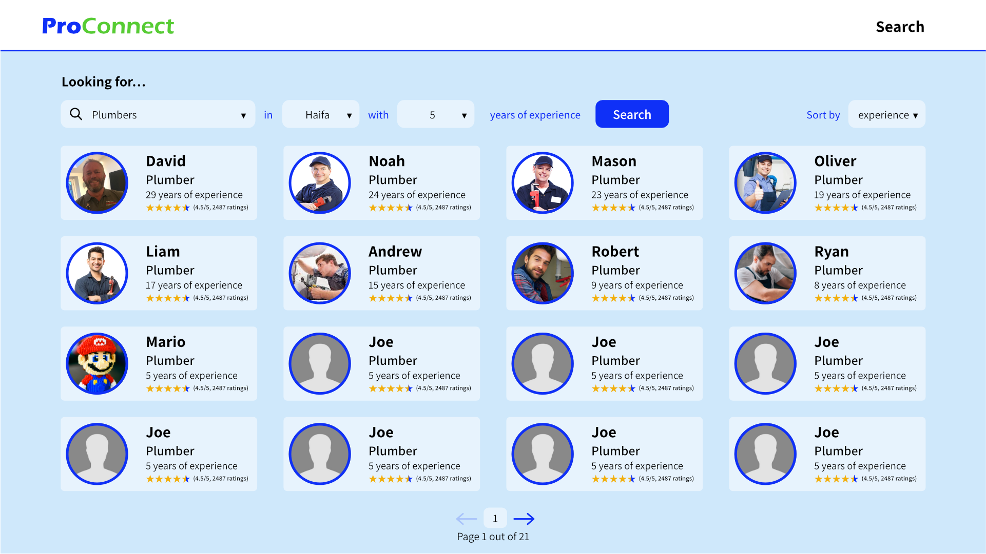
Search Results

Slide 15
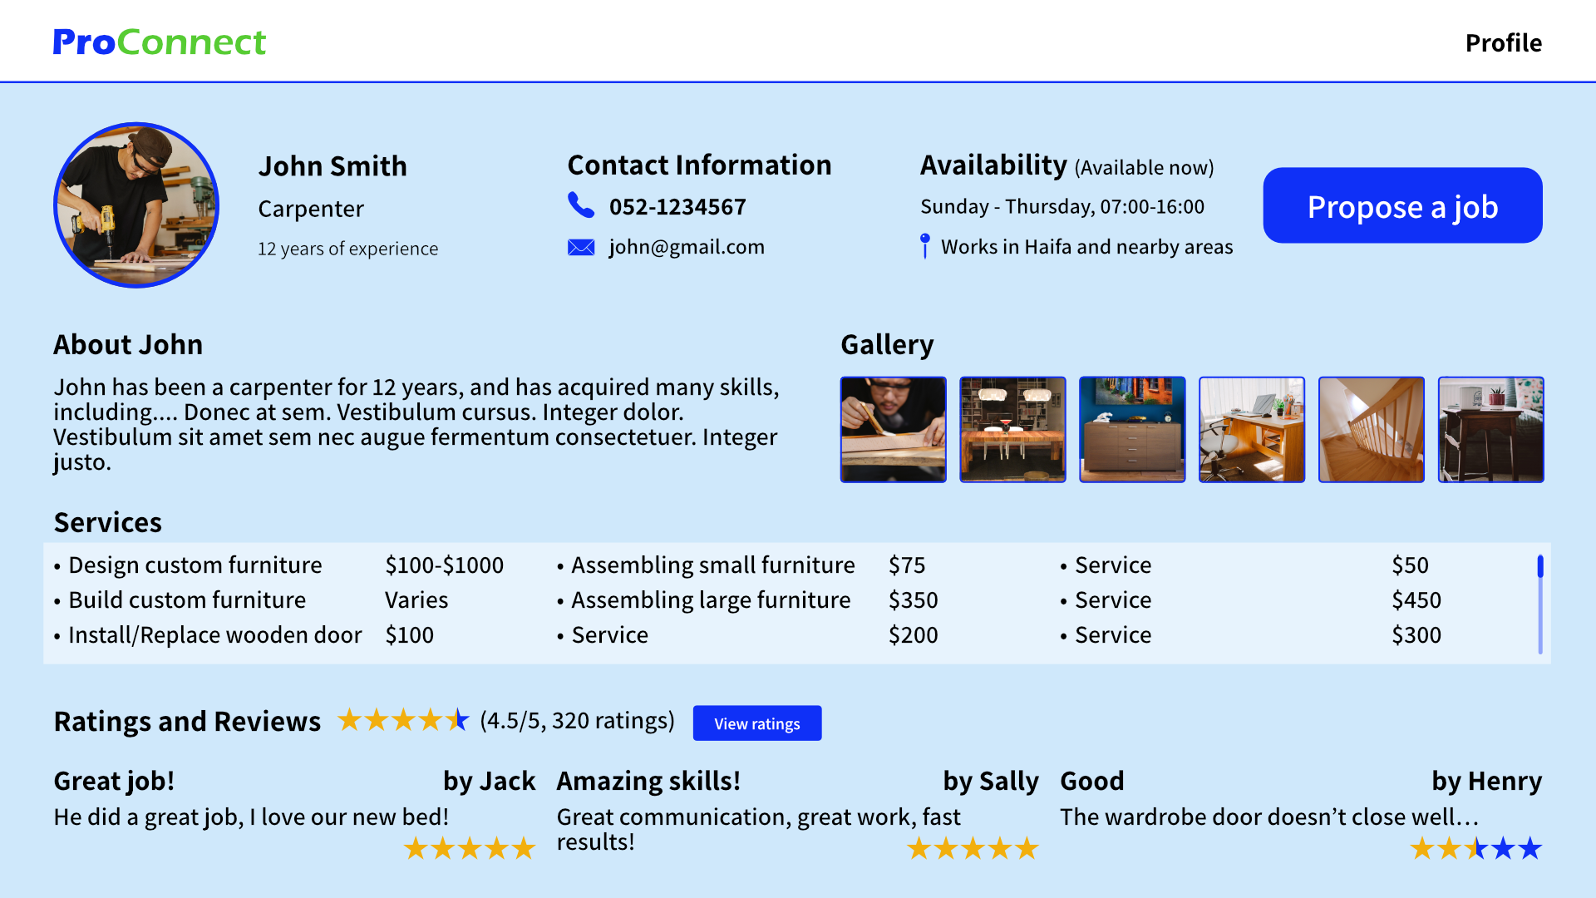
Professional Profile

Slide 16
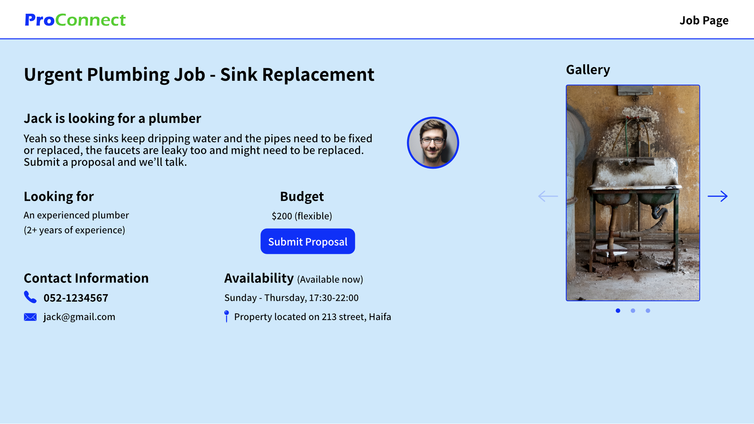
Job Page

Slide 17
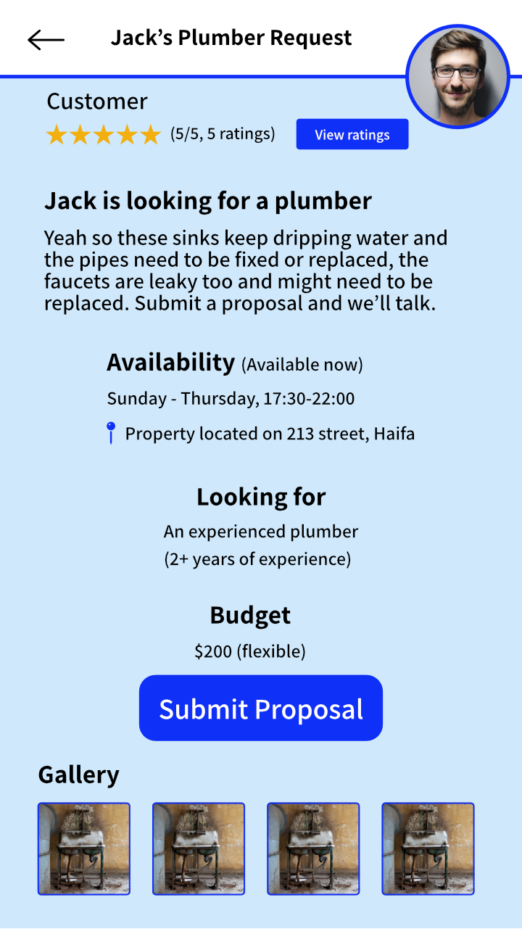
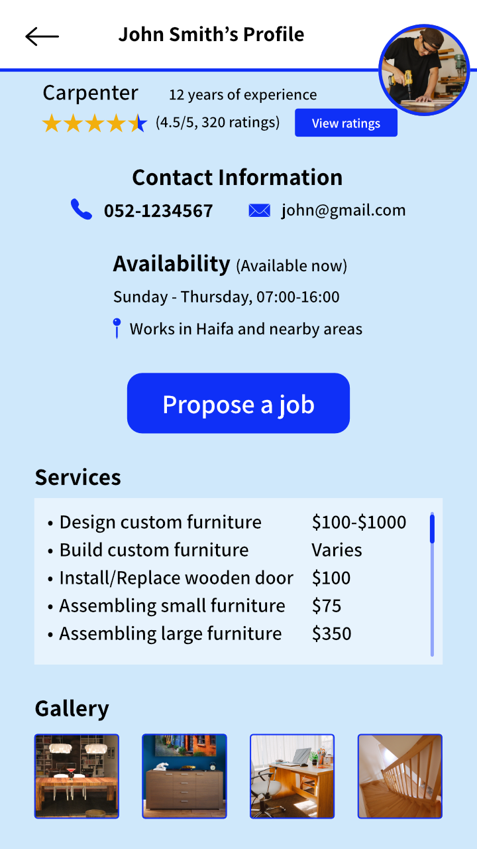
Mobile

Slide 18
Tests
We plan to test a variety of things, both on the back-end and the front-end, including:
Homeowner sending job offers to professionals and contractors
Professionals applying to work with contractors
Sending and receiving messages in chat
Homeowner searching for professionals with filtering

Slide 19
Problems We Expect To Face
Integration between the front-end and the back-end
Learning Spring Boot and React Native at the same time
Finding appropriate people to test the platform and give feedback (homeowners, contractors, professionals and workers)
Deploying the application and hosting it on a web server
Time management issues

Slide 20
Thank you for listening!

Slide 21
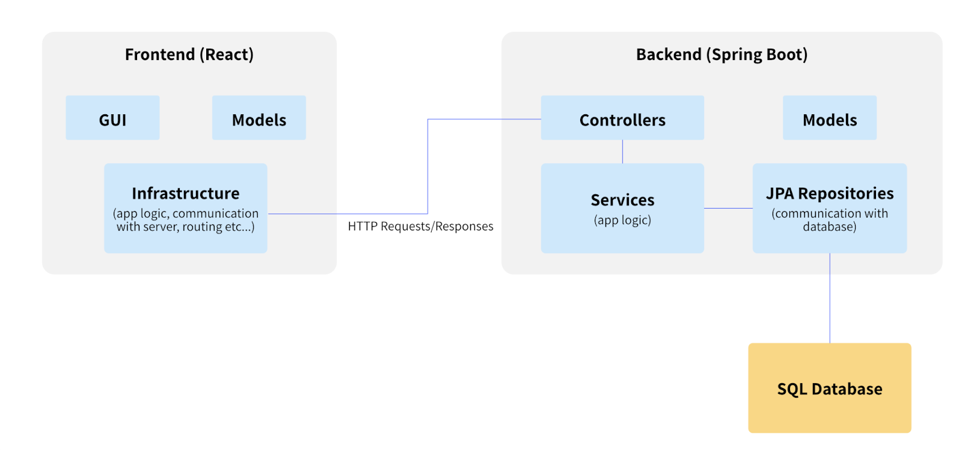
Architecture

